Slide 1


Slide 2
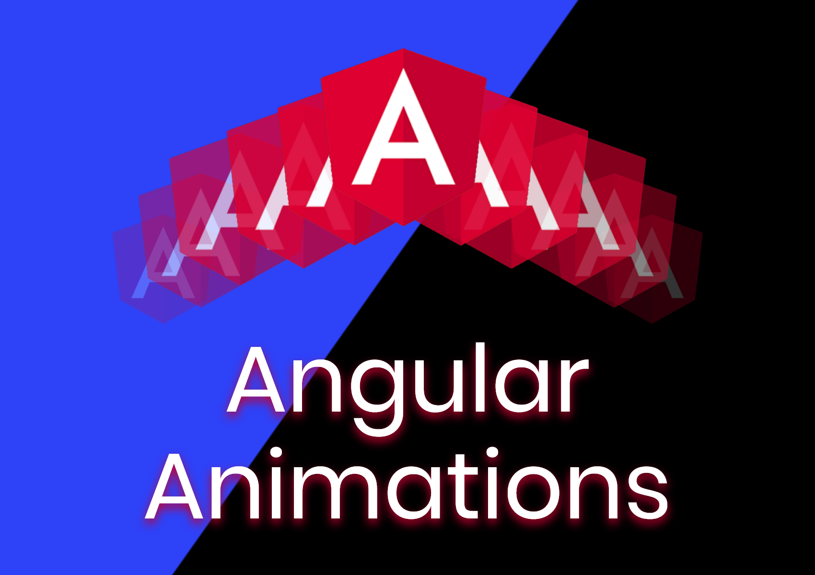
Angular Animations
Angular
55

Slide 3
Angular Animations
Angular
55
Animation provides the illusion of motion: HTML elements change styling over time. Well-designed animations can make your application more fun and easier to use, but they aren't just cosmetic. Animations can improve your application and user experience in a number of ways:
Without animations, web page transitions can seem abrupt and jarring.
Motion greatly enhances the user experience, so animations give users a chance to detect the application's response to their actions.
Good animations intuitively call the user's attention to where it is needed.
Typically, animations involve multiple style transformations over time. An HTML element can move, change color, grow or shrink, fade, or slide off the page. These changes can occur simultaneously or sequentially. You can control the timing of each transformation.

Slide 4
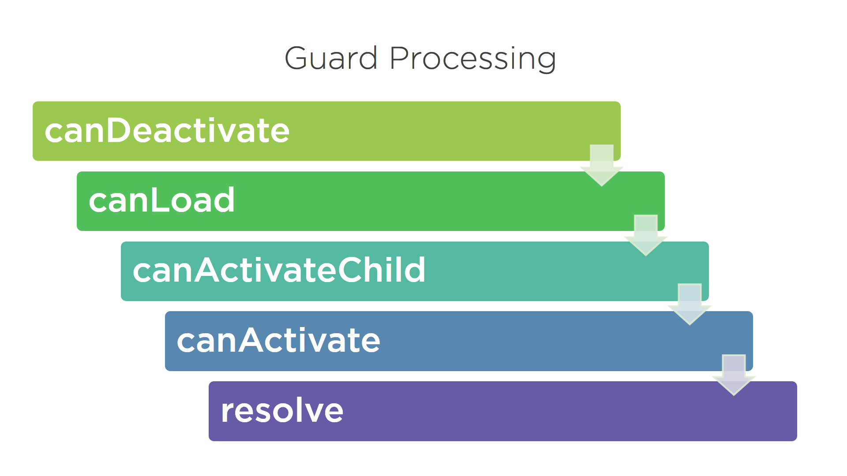
Angular AuthGuard:
Angular
55

Slide 5
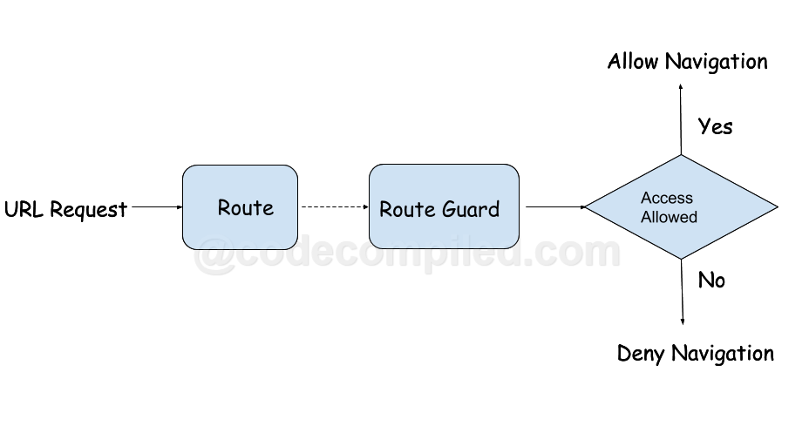
Angular AuthGuard:
Angular
55

Slide 6
Angular AuthGuard:
Angular
55
Different types of angular route guard
Based on user requirement, we can implement different guard. Angular provide following different type of router guards as
CanActivate: Checks to see if we can visit a route based on condition.
CanActivateChild: Checks to see if we can visit route children based on condition.
CanDeactivate: Prevent the user from navigating away from the current content based on condition.
canLoad:Used to determine whether the user can navigate to a lazy loaded module prior to loading it
Resolve: Delay navigation until a task is complete before route activate.

Slide 7
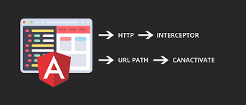
Angular CANACTIVATE :
Angular
55

Slide 8
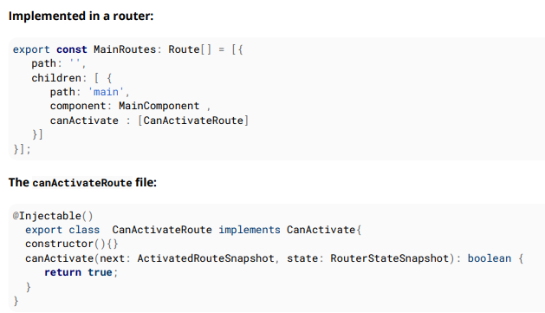
Angular CANACTIVATE :
Angular
55

Slide 9
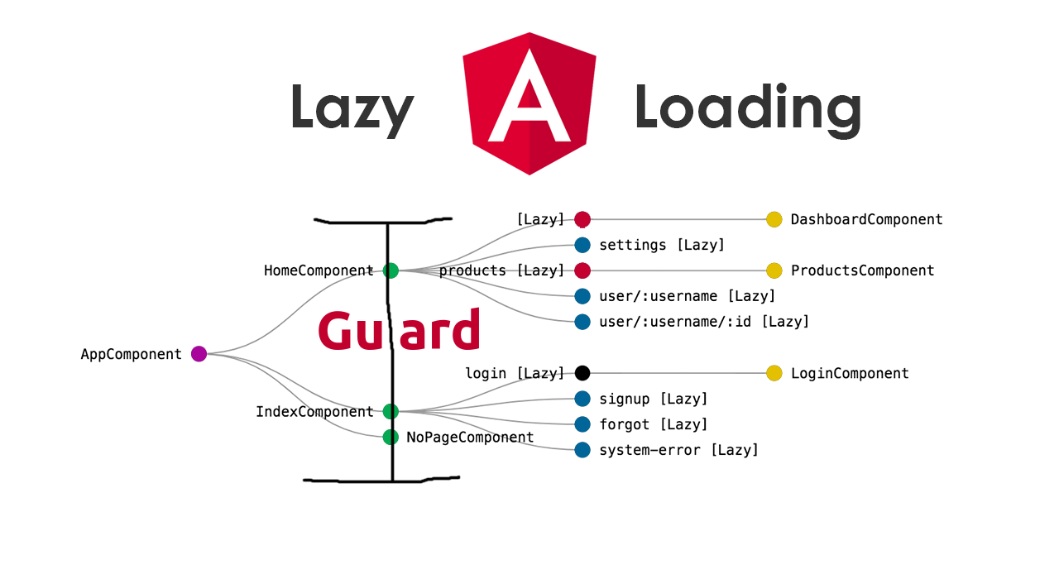
Angular Lazy loading:
Angular
55

Slide 10
That’s All For Today Day-10 !!
Questions?

Slide 11
Thank You
shiva1991@live.com

